Slide 1


How to increase the use of effective nature-based solutions in urban planning?
Mario V Balzan, Miriam Grace, Marcus Collier, Davide Geneletti, Lynn V Dicks, Judita Tomaskinova, Anna Sapundzhieva

Slide 2
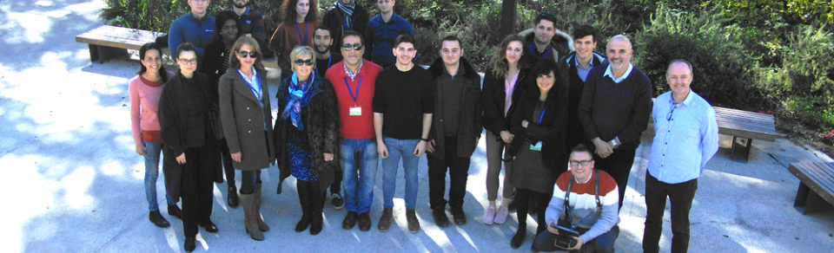
The ReNature Horizon 2020 Project
Key Objectives: capacity building; participatory processes and knowledge synthesis; open data generation and sharing; transition of research into practical solutions
Key themes:
  sustainable landscape design and planning;
  evidence-based policy;
  developing a National Research and Innovation Cluster

Slide 3
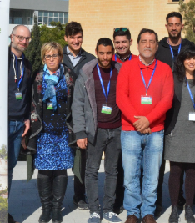
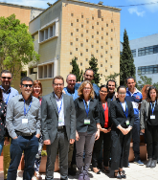
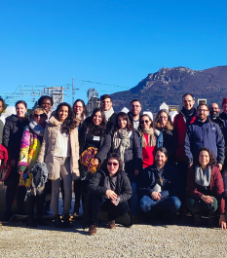
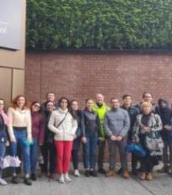
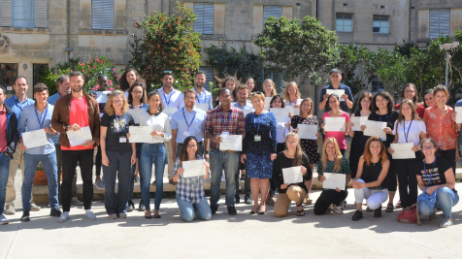

Capacity building to promote research excellence
Techniques and methods in biodiversity and land monitoring
Mainstreaming nature-based solutions in planning and policy-making
Nature-based solutions in urban planning
Nature-based solutions in rural landscapes
ReNaturing Cities – interdisciplinary approaches

Slide 5
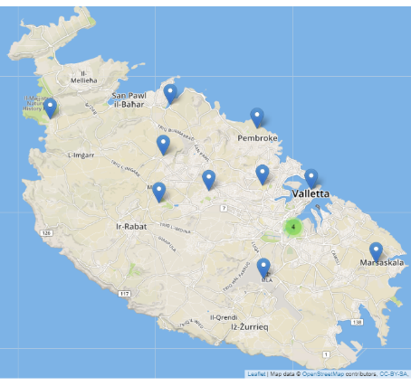
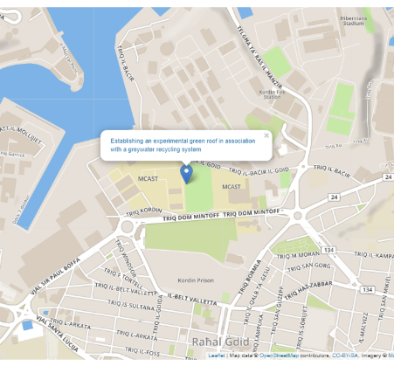

Transition of research into practical solutions: creating a nature-based solution blueprint and toolbox
The ReNature NBS Compendium is available from here:
http://renature-project.eu/compendium

Slide 6

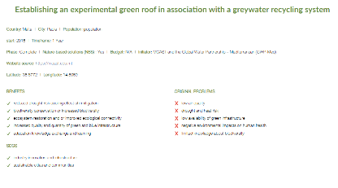
Transition of research into practical solutions: creating a nature-based solution blueprint and toolbox
The ReNature NBS Compendium is available from here:
http://renature-project.eu/compendium
You can help us develop the ReNature NBS compendium further. Submit your NbS entry at ecology@mcast.edu.mt

Slide 7
Strategic approach to ReNaturing Cities
NbS actions
Evidence-based responses and deployment of NBS
Evaluate Challenges
Evaluate societal challenges
Involve
Involve stakeholders and consider the evidence basis
Evaluate NbS
Evaluate NBS using multi-disciplinary & transdisciplinary knowledge, concepts and methods

Slide 8
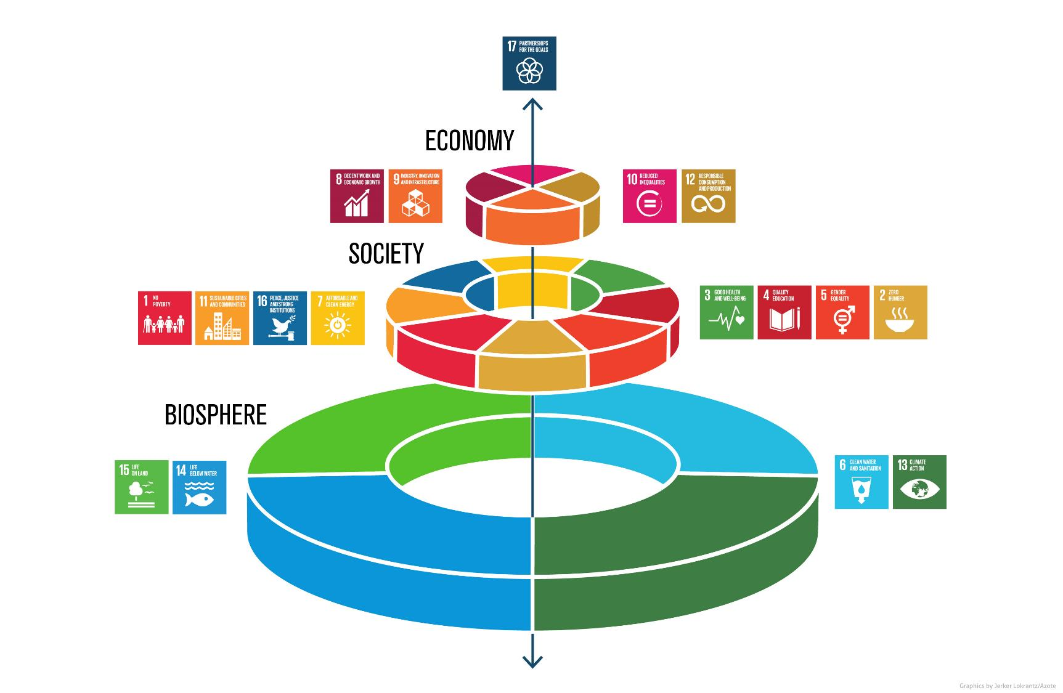
Source: presentation J. Rockström and P. Sukhdev at EAT conference

Slide 9
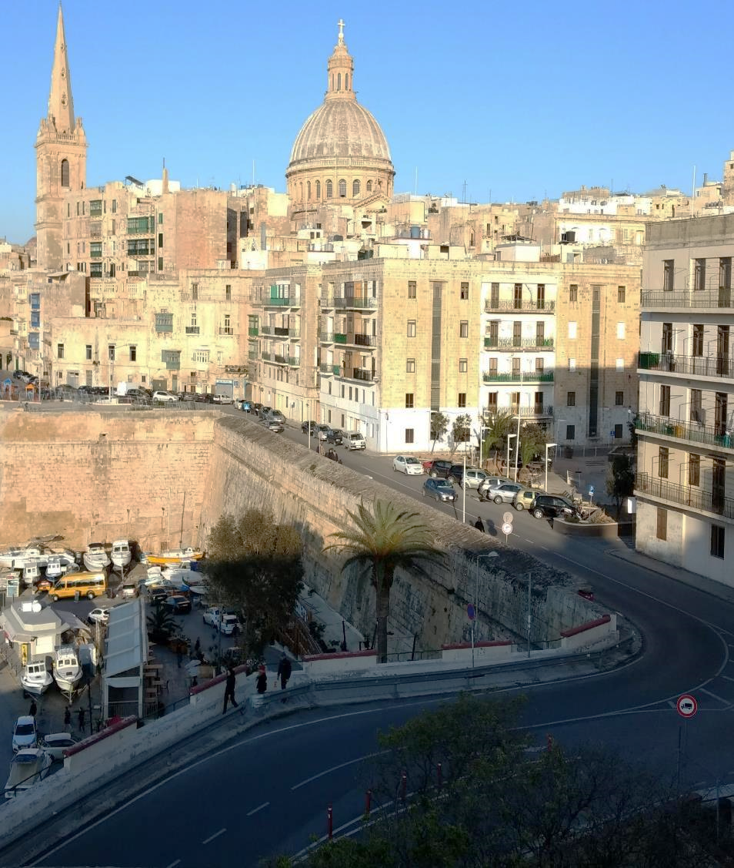



Urban ecosystem services
Ecosystem services are directly associated with green infrastructure area
Green infrastructure declines with an increase in population density
ES Capacity
GI
GI
Population Density

Slide 10
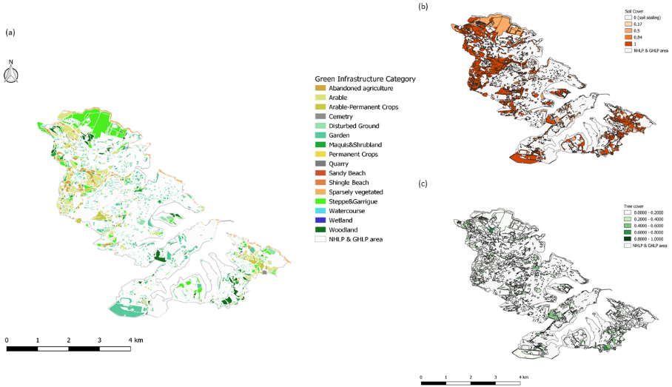
Urban ecosystems
Soil sealing in urban areas
Most of the GI is on the periphery of urban areas
Generally, low tree cover
(Balzan et al., submitted)

Slide 11
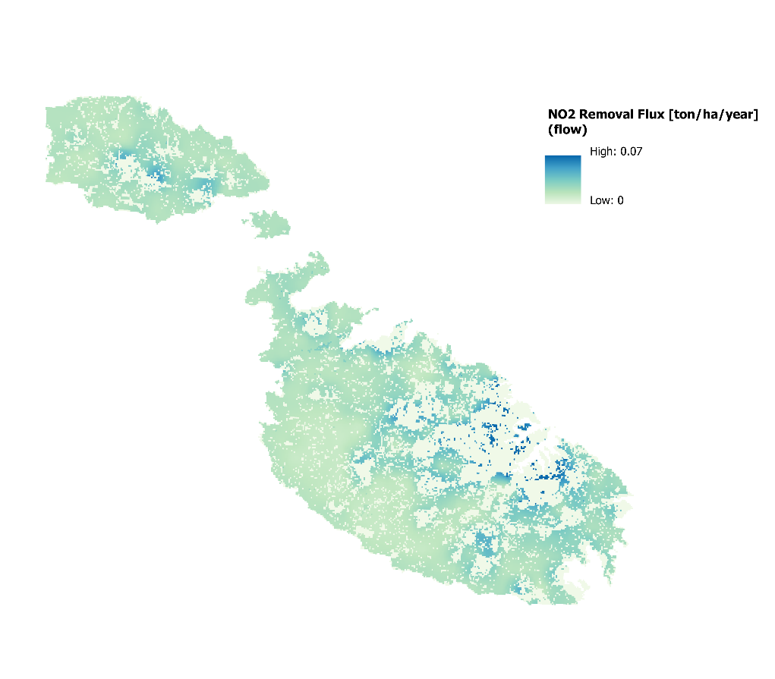
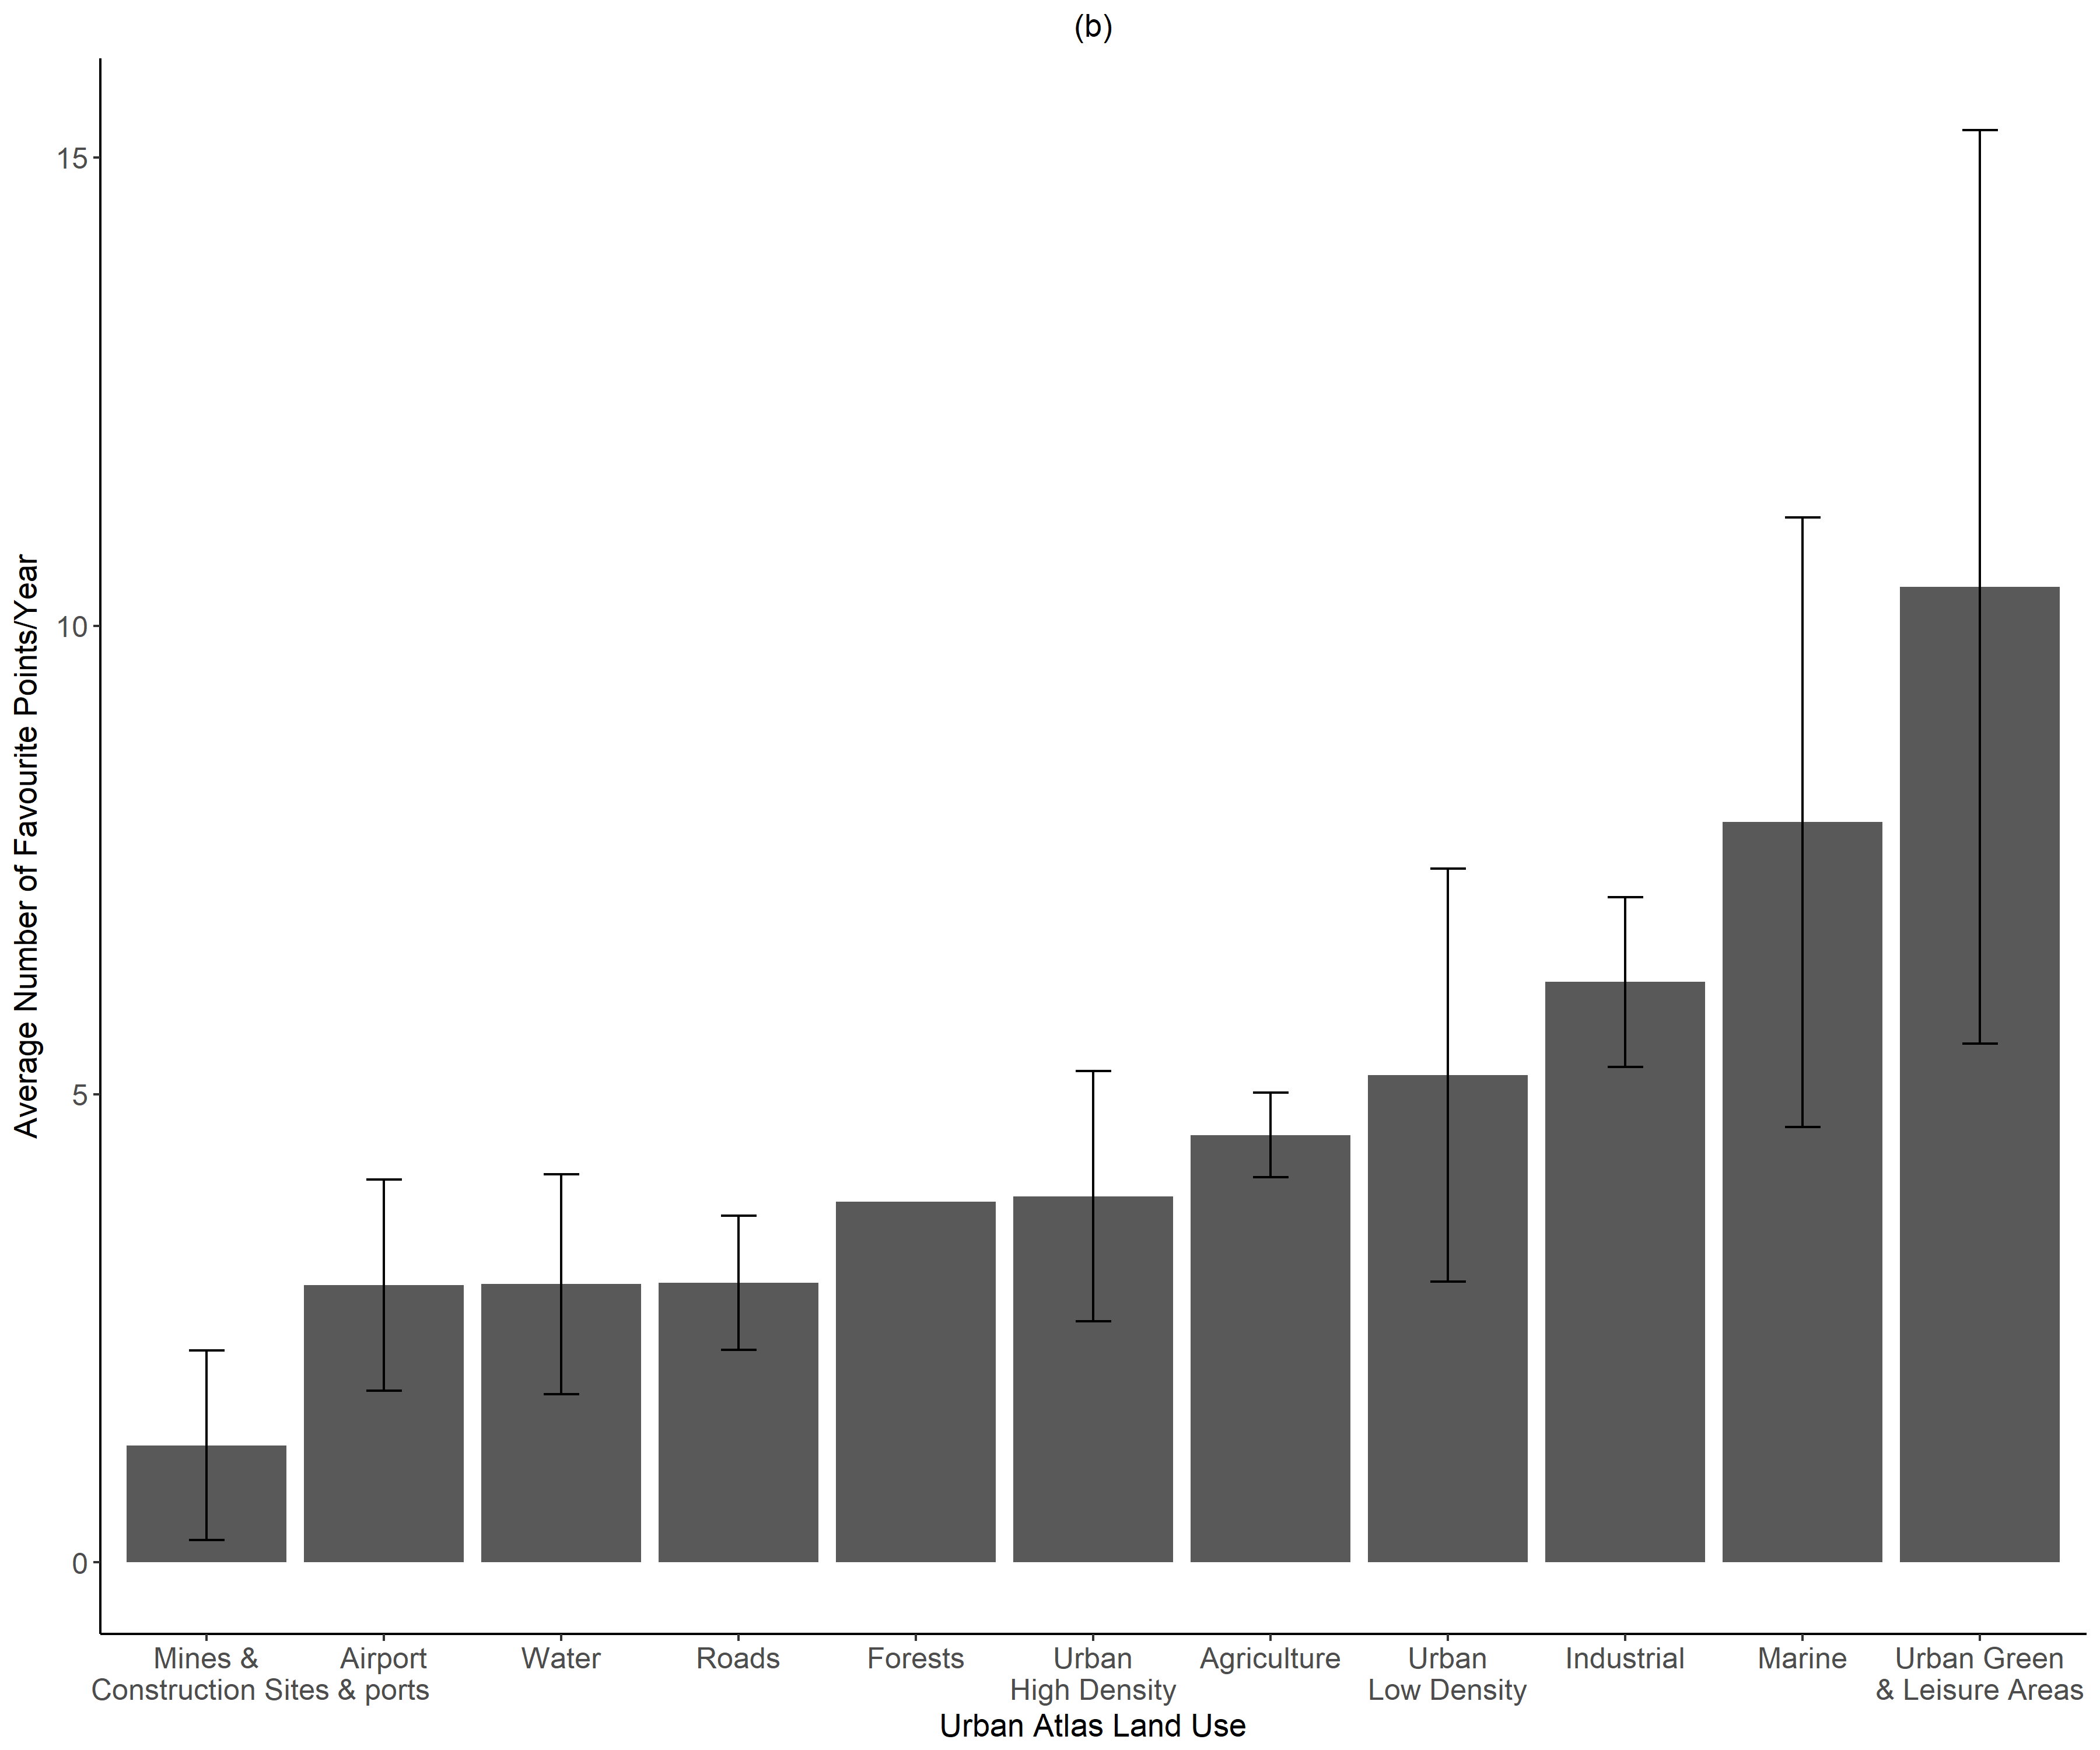
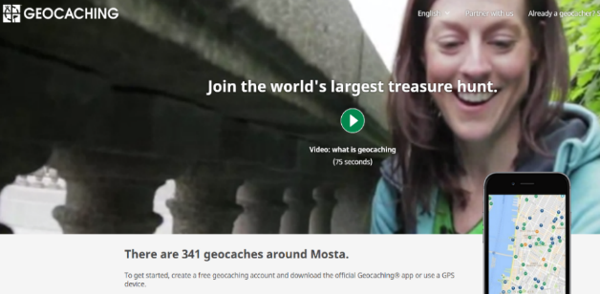
Source: Balzan et al., 2018, Land Use Policy
Source: Balzan & Debono, 2018, One Ecosystem
Recreational value
Cities as coldspots of ecosystem service supplies?
But, the rate of ecosystem service use is much higher in urban cores!
Importance of assessing different dimensions of ES supplies and use

Slide 12
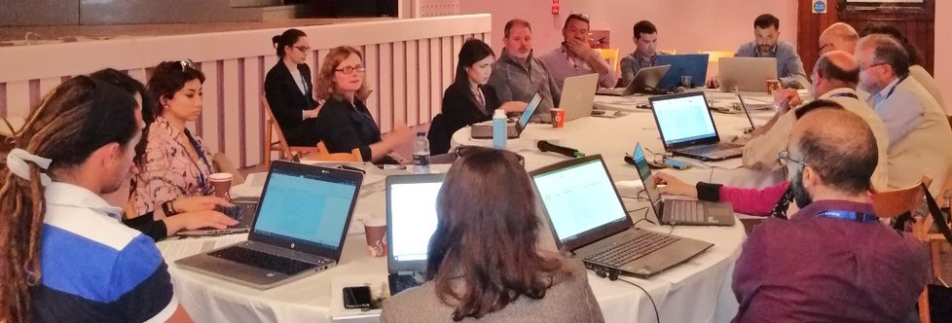
Greater use of NBS in the Mediterranean islands depends on meeting key knowledge gaps limiting implementation
Workshop to develop a collaborative, stakeholder-led set of priority knowledge needs
Malta, May 2019
Source: Grace et al. 2020

Slide 13
18 environmental stakeholders – local and national government, NGOs, business and research
Malta, Cyprus, Sicily and Sardinia
Malta, May 2019
Source: Grace et al. 2020

Slide 14
Knowledge Need (KN) | Category | Median rank | Inter-quartile range | Next steps to address KN
 |  |  |  | Knowledge synthesis and research | Policy and business action
Need for a more precise definition: what exactly are NBS? | NBS options | 6.5 | 2.00-10.75 | ✓ | ✕
Which NBS are adapted to dry Mediterranean conditions to minimise irrigation needs? | Implementation | 11.5 | 8.00-19.00 | ✓ | ✕
How to increase the adoption and actual use of NBS in urban plans? | Capacity and policy levers | 11.5 | 5.00-18.00 | ✓ | ✓
How can new or existing buildings and built-up areas be modified to accommodate green infrastructure? | NBS options | 12 | 5.00-16.25 | ✓ | ✓
Cost-benefit analysis of urban green spaces - long term benefits to human health vs the opportunity cost of not building on land | Cost-benefit | 13.5 | 6.00-19.00 | ✓ | ✕
Grace et al. 2021 (Environmental Science & Policy)

Slide 15


Barriers & opportunities to NbS implementation at national/local scales
This Photo by Unknown Author is licensed under CC BY-SA-NC
Political Dimension:
  Guidance by regional and national policies
  Public support
  Financing Mechanisms
  Low institutional capacities and collaboration;
  Lack of quantitative targets
Knowledge Dimension:
  R&I
  Quantification of costs and benefits
Balzan et al. (submitted)
This Photo by Unknown Author is licensed under CC BY-SA

Slide 16
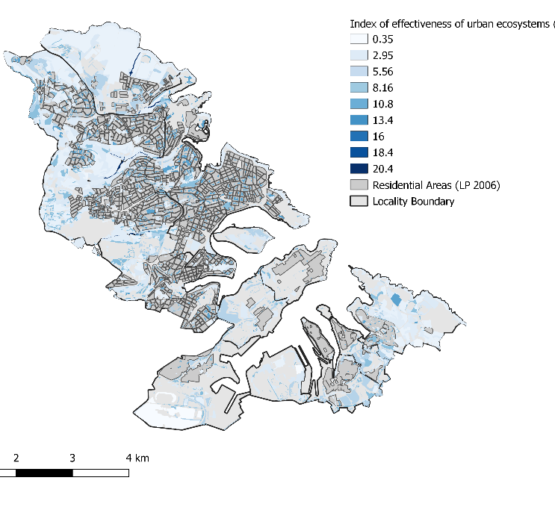
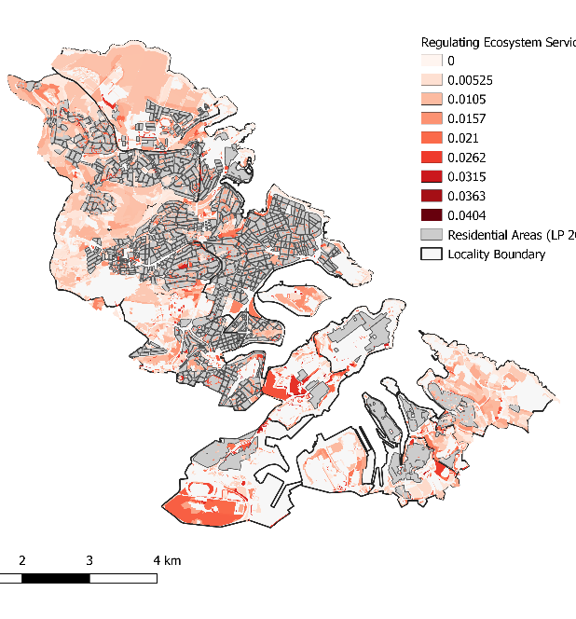
Index of Effectiveness Regulating Ecosystem Services
The index of effectiveness of urban ecosystems is a measure of relative contribution of urban ecosystems to ecosystem service provision based primarily on ecosystem condition (preliminary data shown here).
The less land required to produce an urban ecosystem service, the more effective the urban ecosystem.

Slide 17
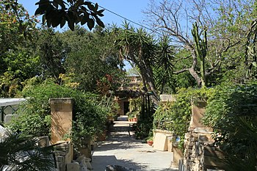
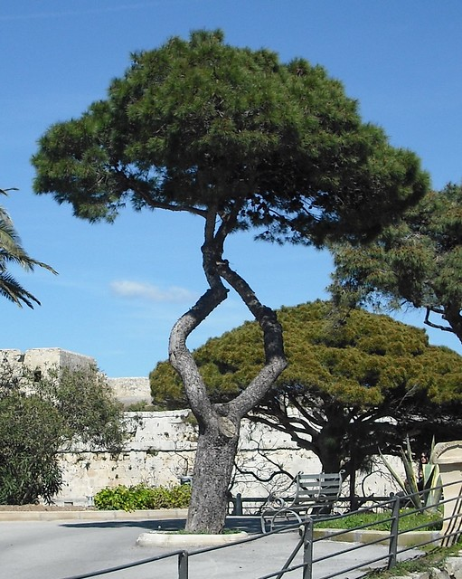
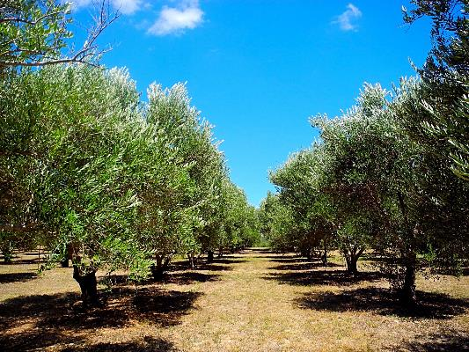
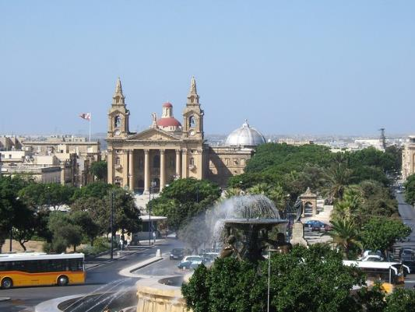

High index of effectiveness values recorded for:
This Photo by Unknown Author is licensed under CC BY-SA
Private gardens
This Photo by Unknown Author is licensed under CC BY-NC-ND
Permanent crops
This Photo by Unknown Author is licensed under CC BY-SA
Urban woodlands and afforested areas
This Photo by Unknown Author is licensed under CC BY-SA-NC
Green streets

Slide 18
Notes:
Private gardens, green streets and landscaping, and afforested areas high ecosystem service capacities per unit area. On the other hand public gardens and some semi-natural ecosystems had low index of effectiveness values.

Slide 19
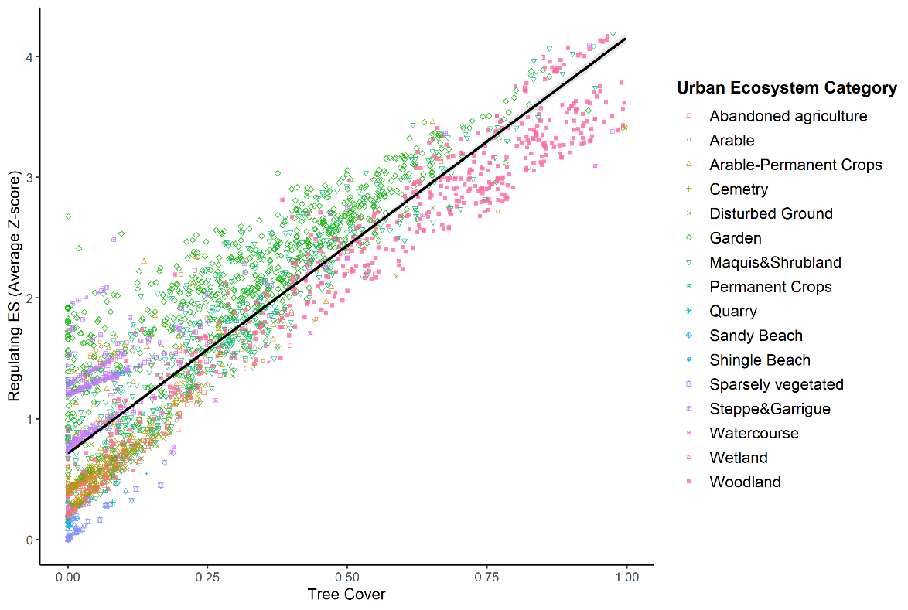
Regulating Ecosystem Services

Slide 20
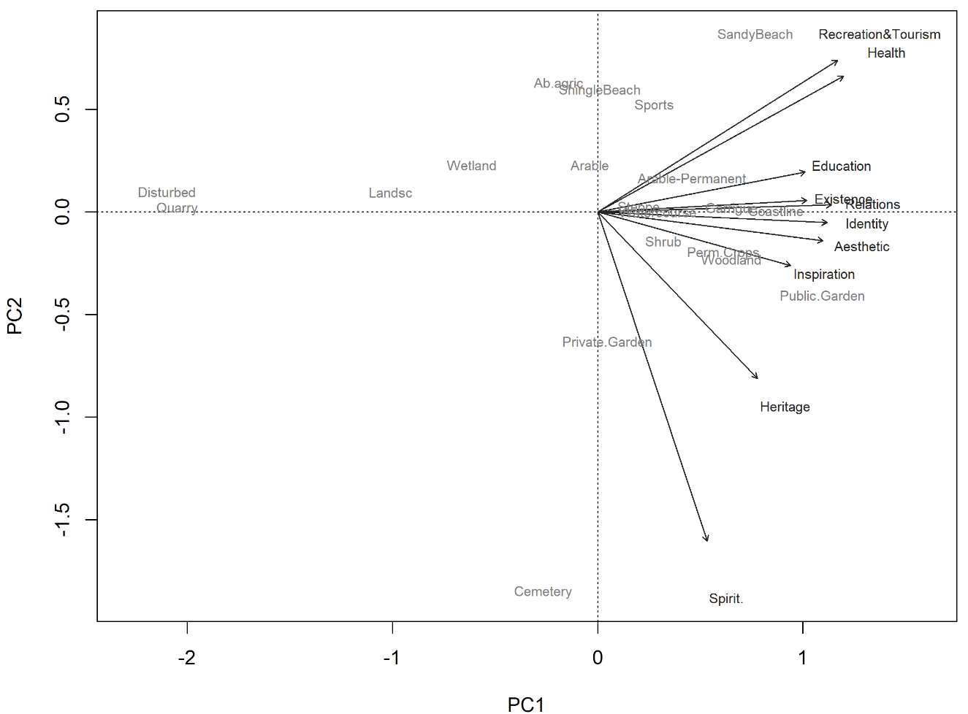
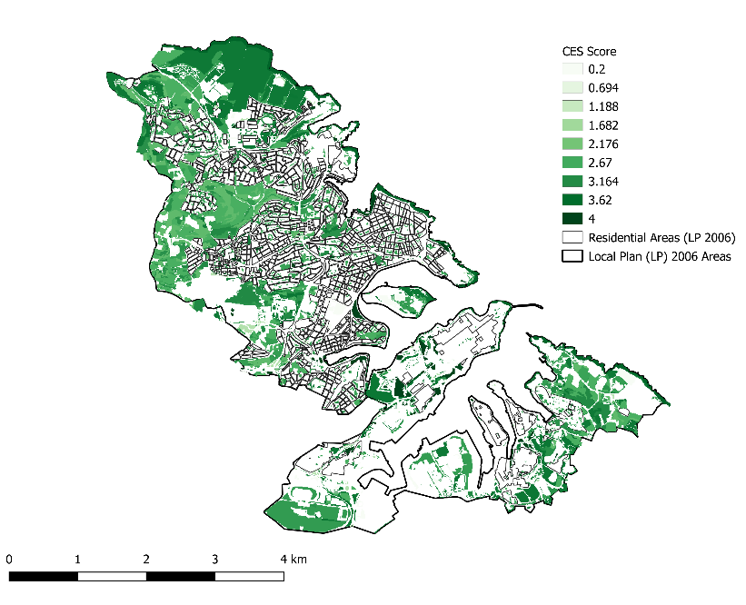
Cultural Ecosystem Services

Slide 21
How to increase the use of effective nature-based solutions in urban planning?
Sharing experiences

